Slide 1
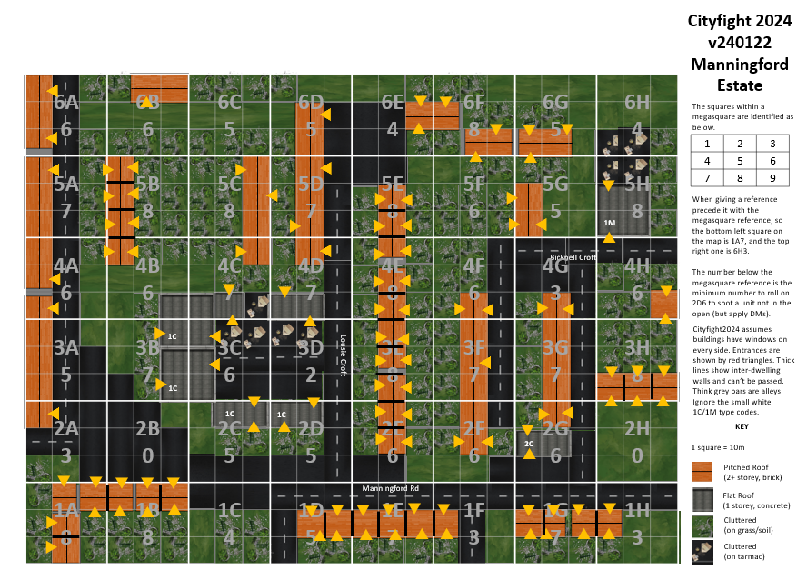










































































LR
6

Slide 2

LR
6
BACKUP COPY

